Slide 1

USED CARS PRICE PREDICTION Group 6
Mentors: Patrick Bormann, Robert Kübler
Participants: Adithya, David, Dayo, Server, Giuliana
September 25th, 2021
DATA SCIENCE TRACK
Notes:
Estimating price of 2nd car price difficult for both seller and buyer
Buyer – as low as possible
Seller – as high as possible to make profit
Model would make decision easier for both, have an ideal price point

Slide 2
Index
Data Cleaning & Transformation
Data Analysis & Exploration
Modeling & Results
Summary
DATA SCIENCE TRACK

Slide 3
Index
Data Cleaning & Transformation
Data Analysis & Exploration
Modeling & Results
Summary
DATA SCIENCE TRACK

Slide 4


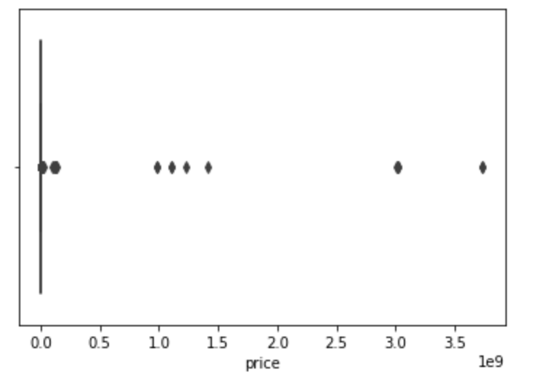
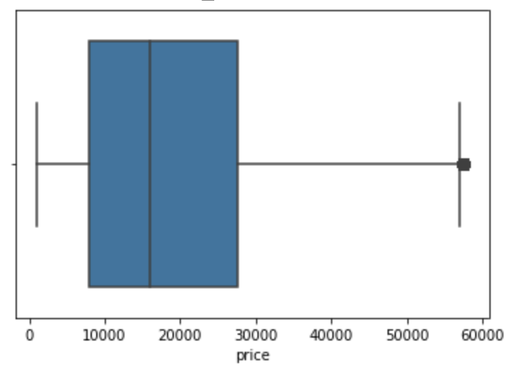



Data Cleaning & Transformation
DATA SOURCE
KEY DATA TRANSFORMATION
DATA EXPORT
US
Craiglist.com
Outliers (Price, Odometer) - detect & remove, when applicable
FINAL DATASET
1
Shape
407,552 rows
x 8 columns
2
India
CarDheko.com
Size
3,260,416
observations
Column - drop unnecessary or redundant columns
- harmonize column names across al datasets
3
Germany
AutoScout24.com
Columns
1. Manufacturer
2. Year
3. Odometer (KM)
4. Gear
5. Fuel
6. Country
7. Price (USD)
Null values - replace or drop, when applicable
Data types - change data types to align with values
4
Belarus
Web various
Data unit - harmonize units across all datasets (i.e. odometer in KM, price in USD)
1

Slide 5
EDA
Main insights
Datasets from 4 different countries
107 different manufacturer/brands
Most cars have an „automatic“ gear (~ 280.000)
But only ~2.000 used electric cars are offered
Average odometer value in the merged dataset is ~140.000 km
Year of construction of the cars ranges from 1982 to 2021

Slide 6
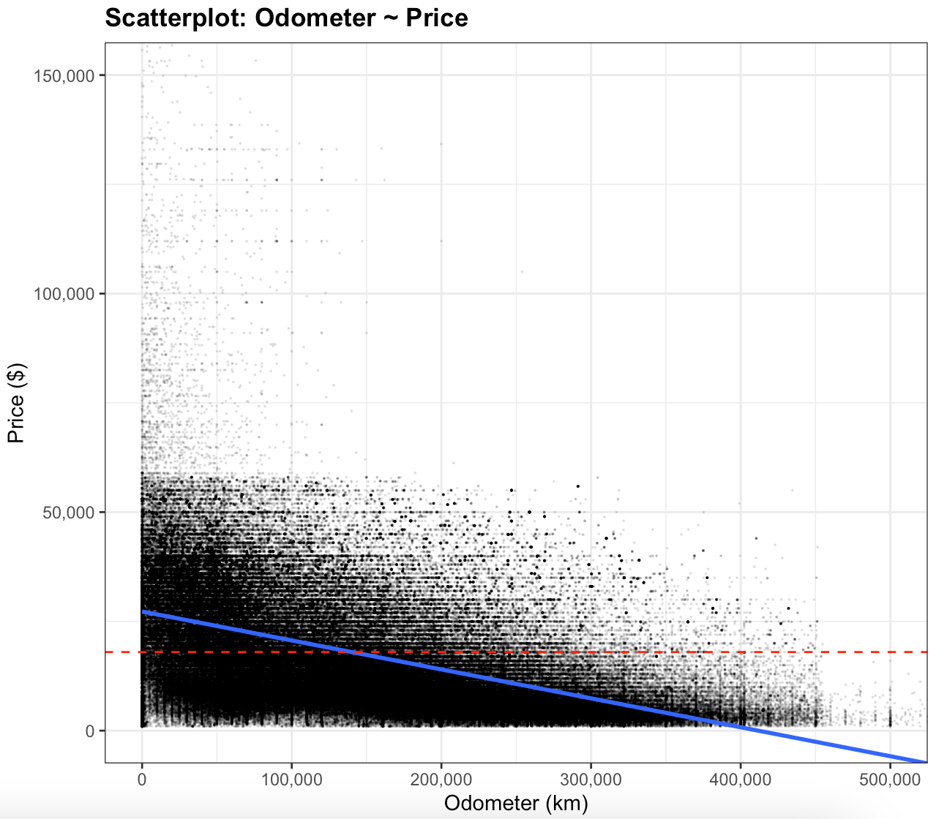
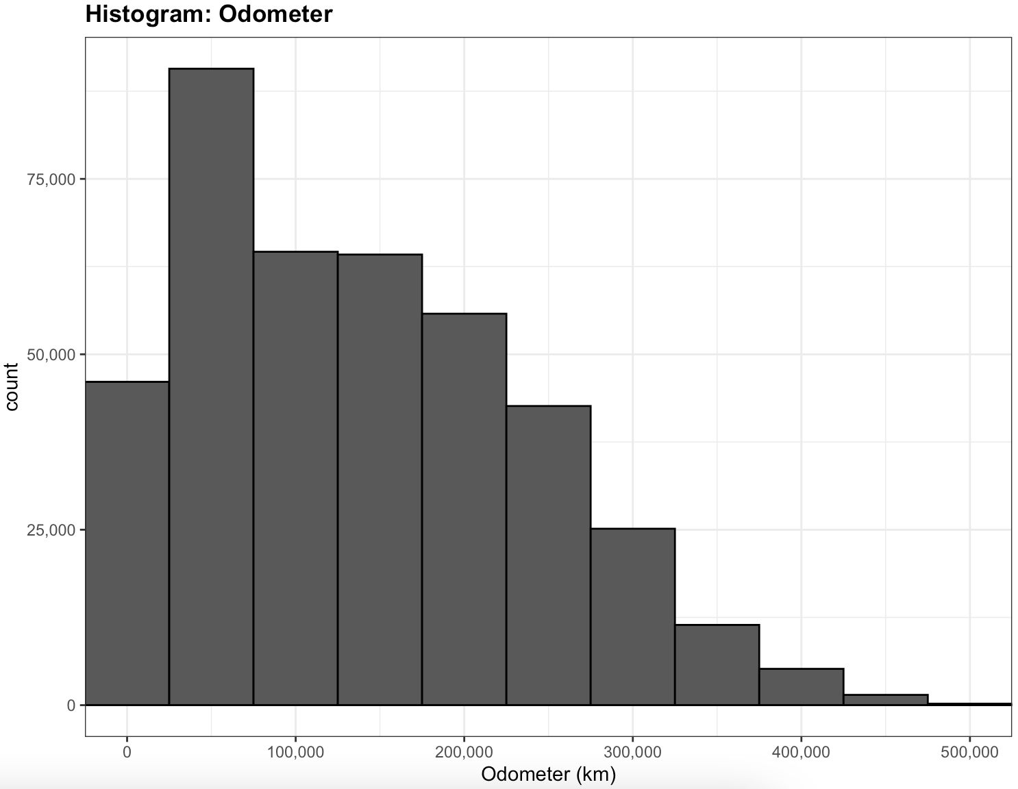
EDA
Example: “Odometer (km)“
Pearson Correlation: Odometer ~ Price: –0,46
🡪 “When odometer value increases, the price will decrease“
Single Linear Regression: Price ($) ~ Odometer (km)
- Intercept: $27.270
- Slope: Odometer (km): -0,07
Mean: 140138
Median: 127106
1st Quartile: 54750
3rd Quartile: 209214
$17985

Slide 7
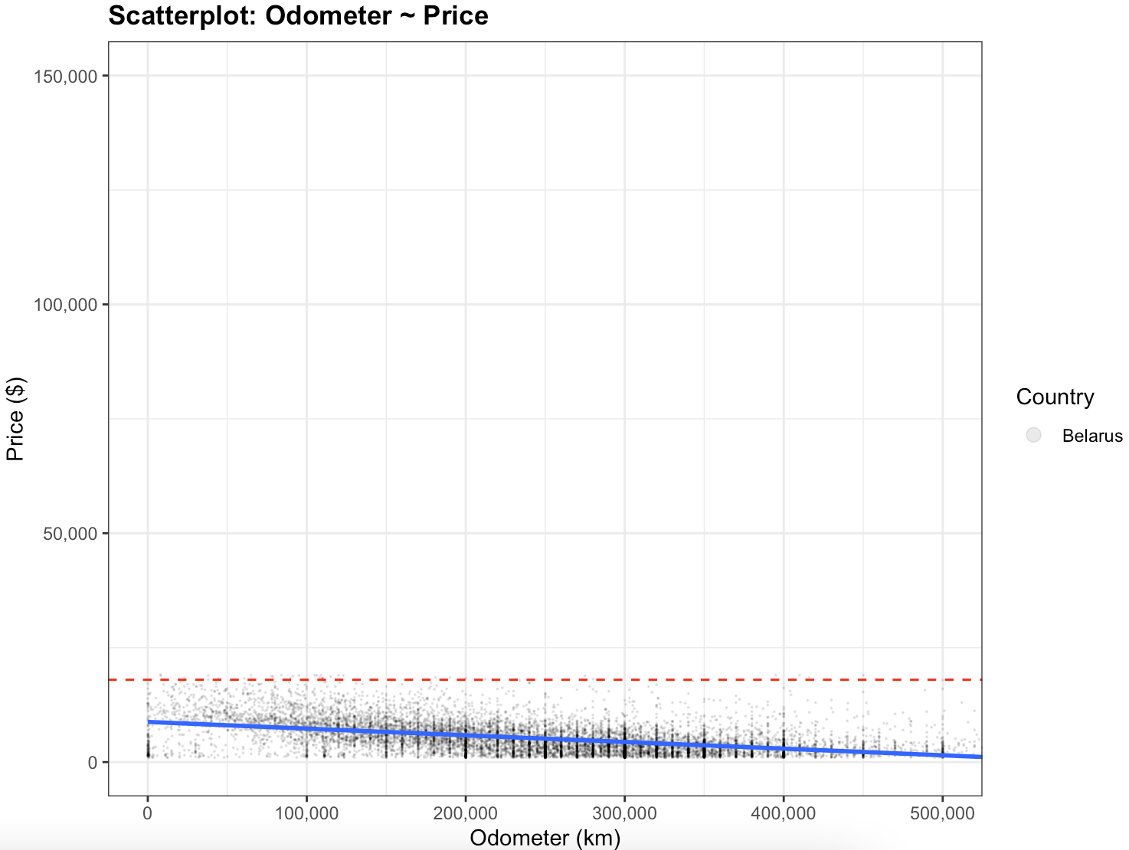
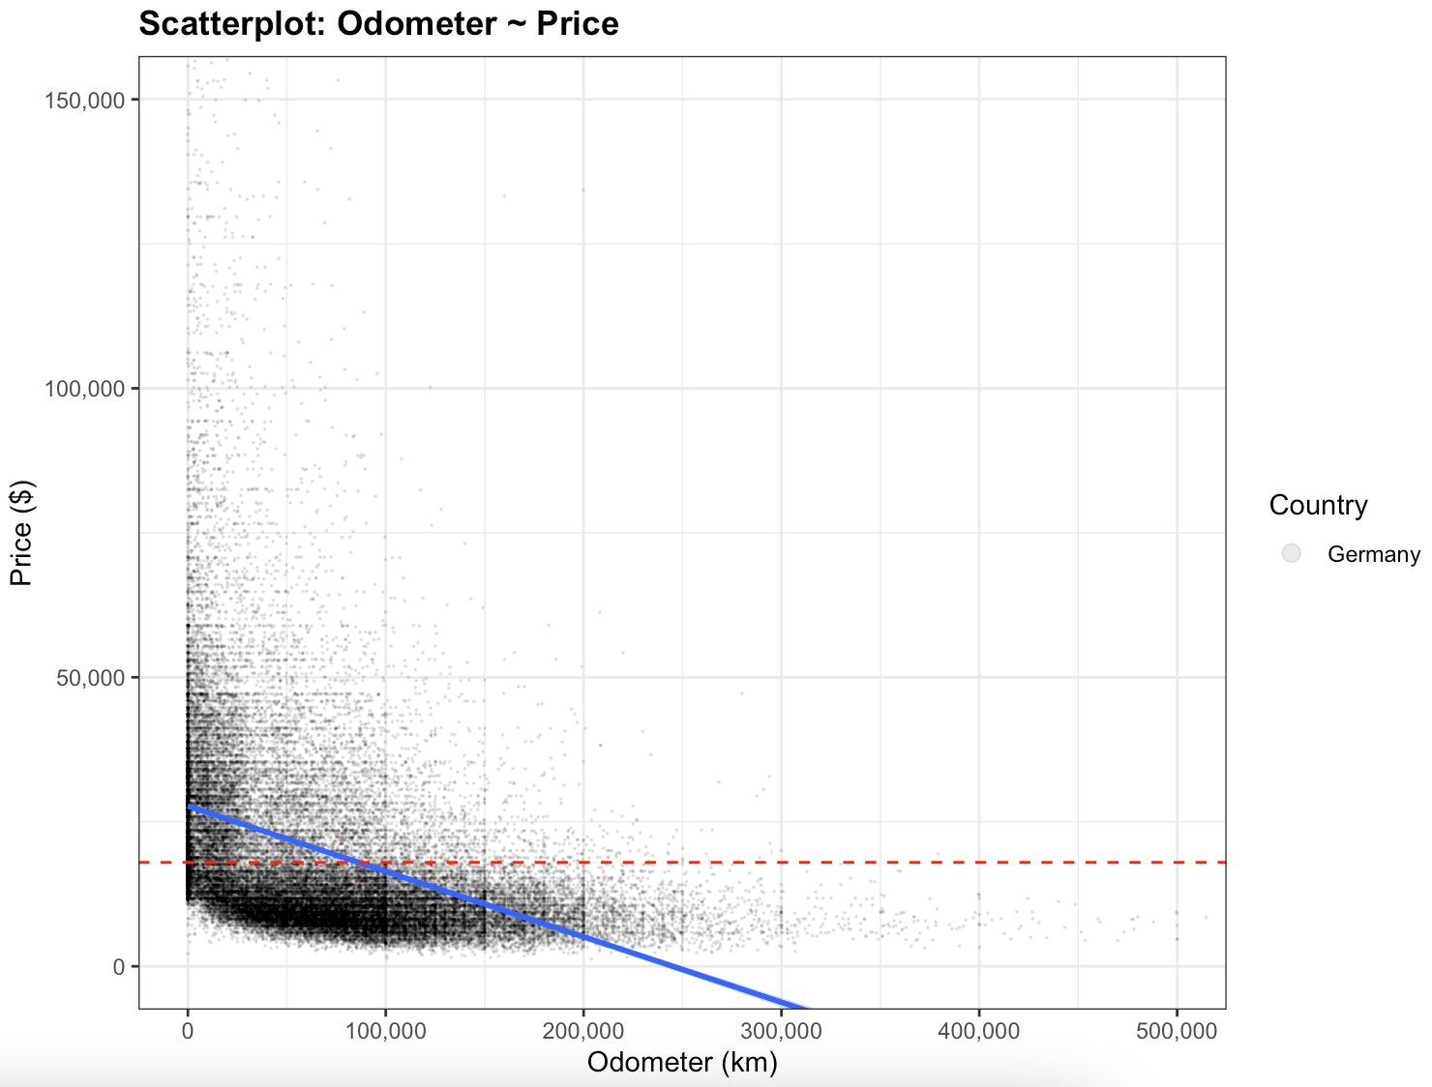
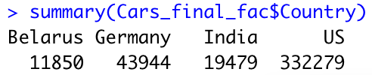
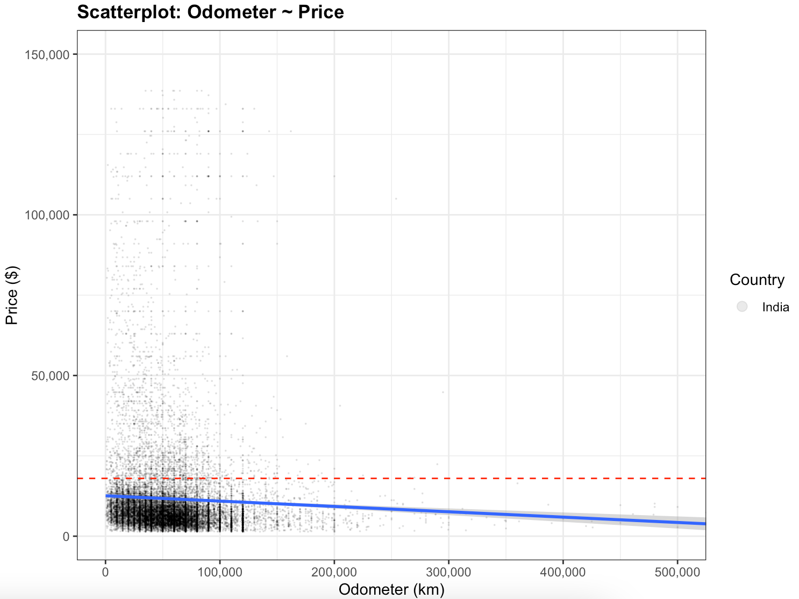
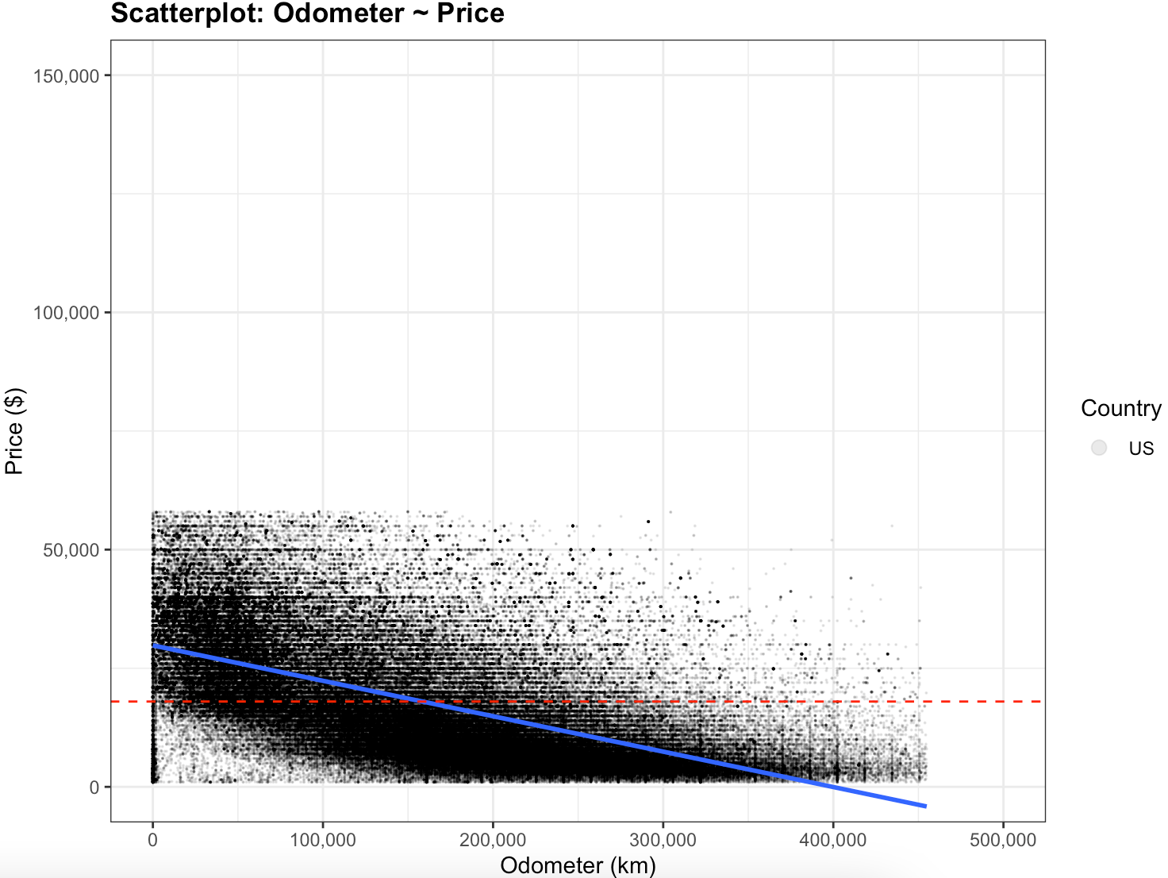
EDA
Example: “Odometer (km)“
Single Linear Regression
Belarus:
- Intercept: $8.772
- Slope: Odometer (km): -0,01
Germany:
- Intercept: $27.730
- Slope: Odometer (km): -0,11
India:
- Intercept: $11.258
- Slope: Odometer (km): -0,02
US:
- Intercept: $29.820
- Slope: Odometer (km): -0,07

Slide 8
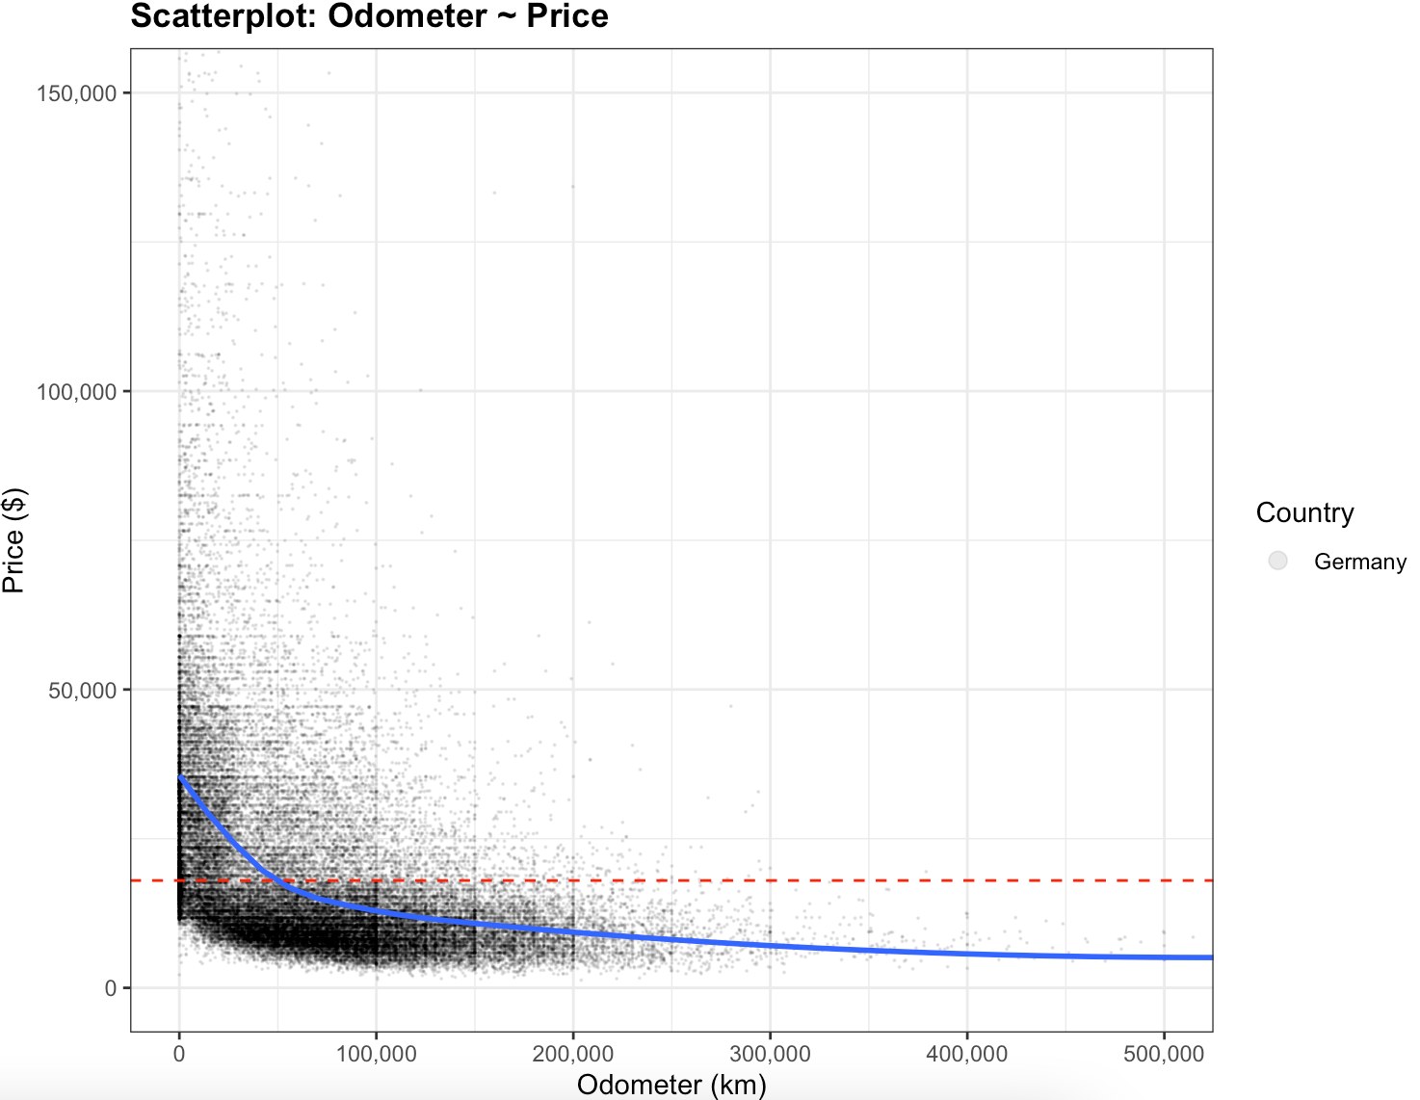
EDA
Example: “Odometer (km)“
Single Linear Regression
Belarus:
- Intercept: 8.772€
- Odometer (km): -0,01
Germany:
- Intercept: 27.730€
- Odometer (km): -0,11
India:
- Intercept: 11.258€
- Odometer (km): -0,02
US:
- Intercept: 29.820€
- Odometer (km): -0,07
Linear Regression:
- Doesn‘t fit perfectly
- In this SLR: Does not predict well for used cars with >250.000 km

Slide 9
EDA
Summary
Variables
Character/Factor
Numerical
Integer
Manufacturer_name
Gear
Odometer in km
Year of construction
Levels: 107 manufacturers
Mode: Ford (61951 )
Levels:
automatic: 281242
manual: 68617
other: 57639
semi-automatic: 54
Mean: 140138
Median: 127106
1st Quartile: 54750
3rd Quartile: 209214
Min: 0
Max: 3800000
Standard deviation: 99519
Mean: 2013
Median: 2014
1st Quartile: 2010
3rd Quartile: 2017
Min: 1982
Max: 2021
Standard deviation: 5,5
Fuel
Country
Price in $US
Levels:
gas: 284380
diesel: 45672
gasoline: 35142
other: 25112
petrol: 9517
hybrid: 5674
electric: 2055
Levels:
US: 332279
Germany: 43944
India: 19479
Belarus: 11850
Mean: 17985
Median: 14450
1st Quartile: 7499
3rd Quartile: 25995
Min: 1000
Max: 1415882
Standard deviation: 14309

Slide 10
Index
Data Cleaning & Transformation
Data Analysis & Exploration
Modeling & Results
Summary
DATA SCIENCE TRACK

Slide 11
Modeling & Results
Linear Regression
GOAL
Predict Selling Price (Target variable) based on the provided features, e.g.: Odometer reading, year manufactured, etc. (Independent variables)
Analytical Approach
Supervised Machine Learning
Regression
Random Forest
Models
Trained
Linear Regression
Decision Trees
Random Forest
(Decision Tree)
8

Slide 12
Modeling & Results
Model
 | RMSE | R2 Score | RMSE | R2 Score
1) Linear Regression | 9678 | 0.54 | 9260 | 0.57
2) Decision Tree | 1937 | 0.98 | 7914 | 0.68
3) Random Forest | 3166 | 0.95 | 6763 | 0.77
Training Data
Test Data
9

Slide 13
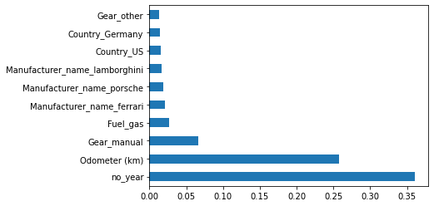
Modeling & Results
Random forest model seems to fit well to the data
Advantages: Accurate and also fits well to non linear data
Disadvantages: cannot be interpreted easily, overfitting
Important features chosen by Random Forest
Hyper-parameter tuning:
🡪 R2 Score before: 0.77
🡪 R2 Score after: 0.77
10

Slide 14


Summary
Main Problem 🡪 How to estimate the price of used cars?
Why 🡪 Buyer-Seller different “ideal” price-points
Solution 🡪 A predictive tool that can make
the decision-process easier for both parties
11

Slide 15
THANK YOU
Group 6

